Slide 1
MATLAB Plot & Statement
Tancy

Slide 2
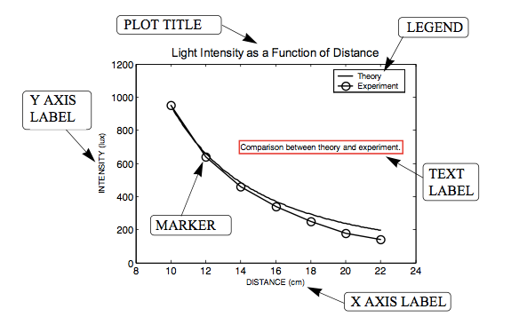

Slide 3
Plot
plot_demo.m
Notes:
Zeros(size(my_mat))

Slide 4
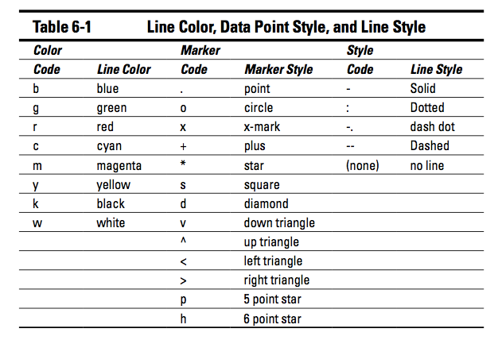

Slide 5
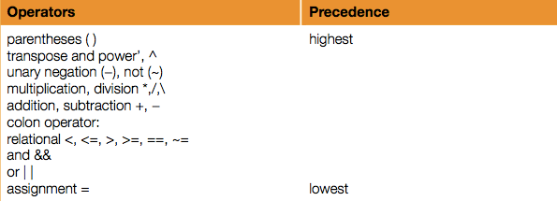
Statement
MATLAB_Lesson1.pptx

Slide 6
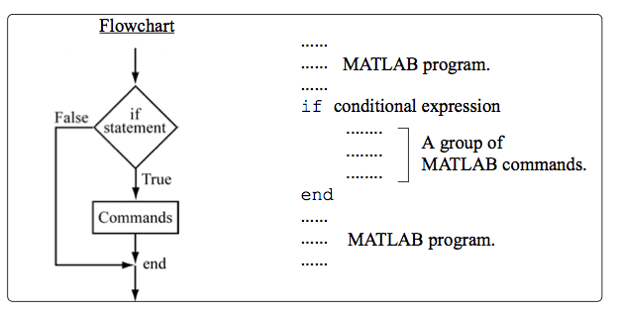
If end

Slide 7
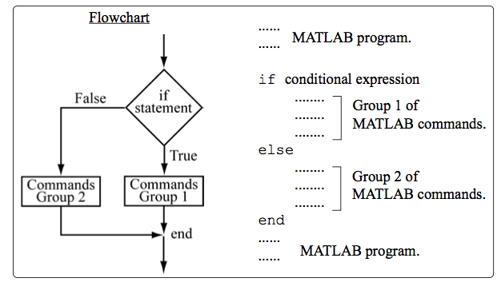
If else end

Slide 8
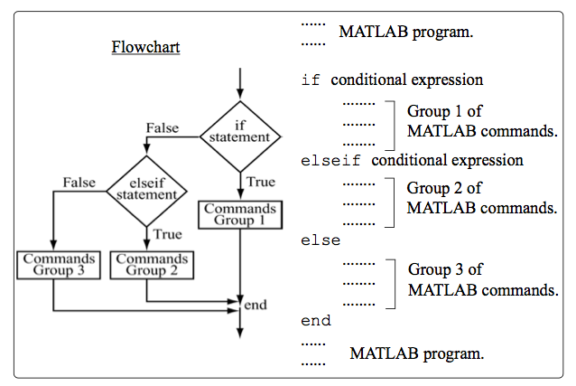
If elseif else end

Slide 9
